Slide 1





Towards a privacy impact assessment methodology to support the requirements of the General Data Protection Regulation in a big data analytics context: A systematic literature review
Authored By:
Georgios Georgiadis∗, Geert Poels
Ghent University,
Faculty of Economics and Business Administration,
Tweekerkenstraat 2, B-9000 Gent, Belgium
Presented By:
Sonu Adhikari,st124409,
Paper Reading as part of course requirement for Business Analytics and Intelligence.

Slide 2

Presentation Outline
01.
02.
03.
04.
05.
06.
INTRODUCTION
BACKGROUND
RESEARCH METHODOLOGY
DISCUSSION AND
FUTURE WORK
CONCLUSION
Q & A

Slide 3



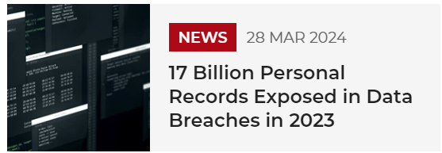

Let’s set the context first…

Slide 4
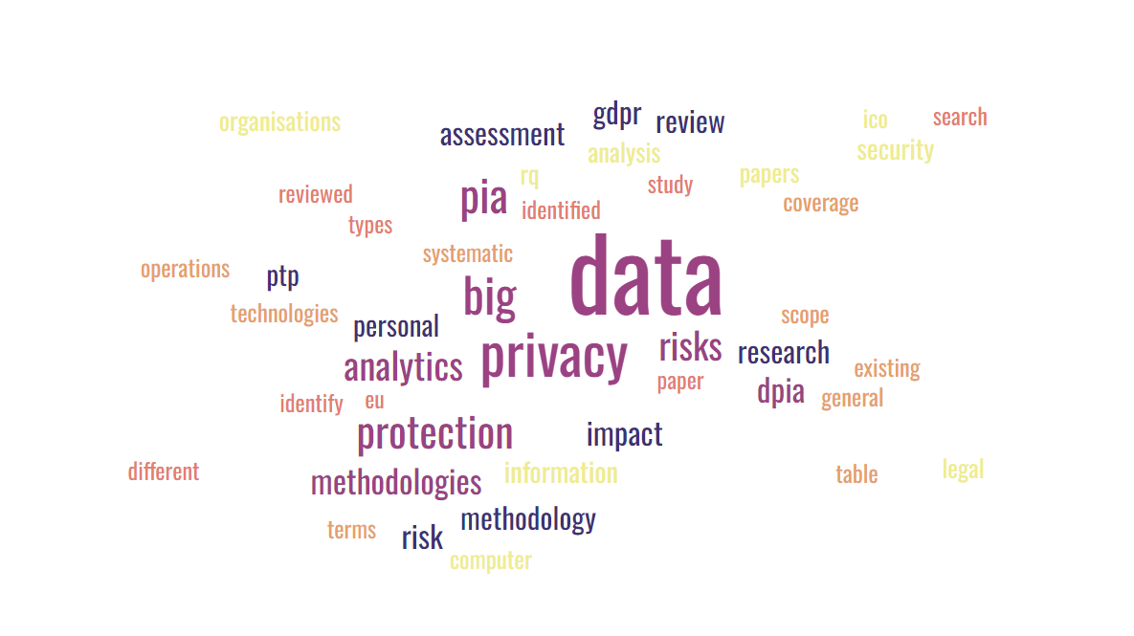

Slide 5
Keywords:
Big data analytics
Data protection
Data protection directive
General data protection regulation
Governance
Information security
Privacy
Privacy impact assessment
Systematic literature review

Slide 6
ABSTRACT
Big Data Analytics has enabled businesses and organizations to process and utilize vast amounts of data, leading to improved efficiency and new opportunities.
However, the benefits of Big Data Analytics are restricted by the unintentionally heightened risk of personal data being compromised or breached.
The GDPR mandates Data Protection Impact Assessments to identify appropriate controls and mitigate risks associated with the protection of personal data.
The research aims to develop a DPIA methodology that addresses the unique privacy and data protection challenges in Big Data Analytics environments.

Slide 7


01.
Introduction

Slide 8
INTRODUCTION
Rapid advancements in the technological areas and social media have facilitated the collection of vast amounts of data, both structured and unstructured.
This ‘big data’ is often too complex to handle with existing data processing frameworks, which has led to the emergence of Big Data Analytics.
While big data analytics offers efficiency and opportunities, it also increases the risk of data breaches, potentially exposing sensitive information.
Therefore, GDPR had been introduced to impose Data Protection Impact Assessment (DPIA) in cases where processing of personal data could impose high risks related to data protection and privacy, that could negatively impact the rights and freedoms of individuals.
Although the concept of the DPIA became known through the GDPR and is regarded as a relatively new instrument in most European member states as well as private and public organisations, it has existed in the form of the Privacy Impact Assessment (PIA)2 since the mid-1990s

Slide 9
02.
BACKGROUND

Slide 10

Privacy in the era of big data
Current Scenario in the world of Big Data
Big Data Analytics create value for a wide range of actors in the global economy
there are some growing concerns, the most pressing of which are related to the secure and lawful processing of personal data
State-of-the-art tools and measures are required to properly manage big data’s so-called ‘5Vs’ (volume, variety, velocity, value and veracity)
GDPR(General Data Protection Regulation)
Data protection regulatory framework across all European member states since May 2018
Fundamental role in shaping digital markets in the European Union (EU).
ensure the fair processing of personal data by setting an array of binding data
protection principles
some authors have assumed that Big Data Analytics cannot adhere to all data protection principles under the GDPR

Slide 11

Privacy Impact Assessment (PIA)
PIA is a management tool that helps organisations identify, analyse and minimise privacy risks, whether organisational or technical
It emerged and fully developed between 1995 and 2005
Helps in informed decision-making by revealing internal communication gaps and hidden assumptions.
Enable organisations to reduce costs in terms of management time, legal expenses, and potential negative media coverage
Opponents of PIAs consider them a costly bureaucratic hassle or forced exercise to appease the legal team
In reality, a properly conducted PIA starts at the beginning of a project, where the cost of change is relatively minimal and influence on project direction is much higher.

Slide 12
Data Privacy Impact Assessment (DPIA) under GDPR
DPIA mandated by the GDPR as a form of PIA whose primary focus is on compliance with the seven fundamental principles of personal data protection at the core of the GDPR
DPIA aims to identify and address issues related to the handling of personal data early in a project’s life cycle.
DPIA and PIA are different concepts though they seem similar. The difference between the two lies in scope and basic value drivers.
PIAs goes beyond the scope of legal frameworks by addressing, for example, general ethical considerations about privacy and personal data handling
DPIA becomes compulsory when the likelihood of data processing activities results in high risk that could negatively impact the rights and freedoms of the individuals whose data are concerned

Slide 13
03.
RESEARCH METHODOLOGY

Slide 14
STEPS OF THE RESEARCH
1. Systematically review all privacy and data protection risks identified in the literature that are relevant to Big Data Analytics and summarise them into 9 Privacy Touch Points(risks).
2. Analyse the coverage of these Privacy Touch Points in 10 PIA methodologies that received attention in the publications sample.
3. Reveal strengths and weaknesses of existing PIA methodologies when used in Big Data Analytics environments and help in the development of an enhanced methodology for conducting a DPIA

Slide 15
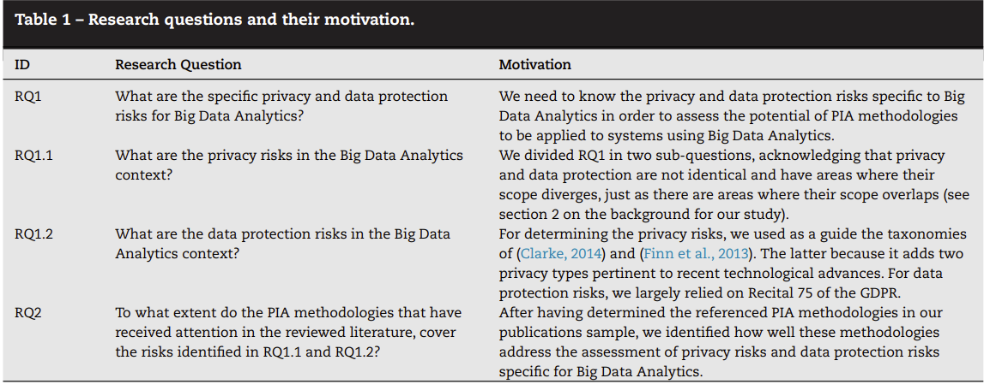
Research Questions

Slide 16
RQ1: What are the specific privacy and data protection risks for Big Data Analytics?
Nine key risks or harms associated with the storage of Big Data and the application of Big Data Analytics.
Four of these risks relate more to privacy and five to data protection.
To avoid the abundant use of the term ‘risk’ in the paper, we named these themes ‘Privacy Touch Points’ (PTPs)
PRIVACY RISKS: (PTPs (4), (6), (8) and (9))
DATA PROTECTION RISKS: (PTPs (1), (2), (3), (5) and (7))
Risks = Privacy Touch Points (PTP)

Slide 17
Data Privacy Risks
Lack of transparency: The opacity of contemporary data processing activities, along with how big data are eventually used, may have nothing to do with the purpose set or anticipated at the time of initial data collection
Treatment of indirect privacy harms: societal and ethical concerns aren’t addressed when dealing with big data
Improper treatment of different types of privacy risks and data breaches
Practical issues due to procedural vagueness: Existing PI methodologies are rather vague and theoretical instead of practical

Slide 18
Data Protection Risks
Unclear data controllership: transfer of big data from one place or recipient to another results in a diverse controllership. Consequently, it is difficult to understand and ensure compliance with privacy requirements amongst data controllers
Identification of individuals from derived data: Big Data Analytics techniques enable inferences from undisclosed information that can be used to identify an individual
Discrimination issues affecting moral (e.g. stigmatisation) or material (e.g. reducing the chance of finding a job) personal matters
Increased scope leading to further processing incompatible with the initial purpose
Limited range of stakeholders’ involvement

Slide 19
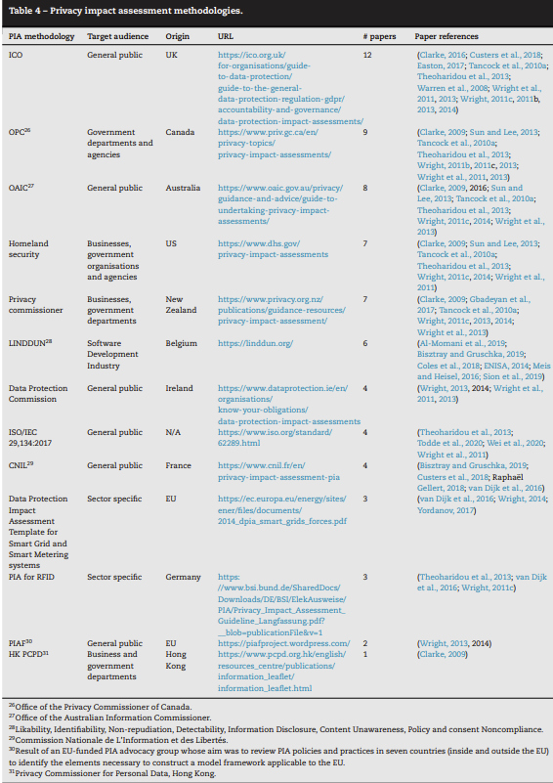
PIA Methodology | Target Audience | Origin
ICO | General Public | UK
OPC | Government Departments | Canada
OAIC | General Public | Australia
Homeland Security | Businesses,government organisations and agencies | US
Privacy commissioner | Businesses,government departments | New Zealand
LINDDUN | Software Development Industry | Belgium
Data Protection Commission | General public | Ireland
ISO/IEC 29,134:2017 | General public | N/A
CNIL | General public | France
Data Protection Impact Assessment Template for Smart Grid and Smart Metering systems | Sector specific | EU
PIA for RFID | Sector Specific | Germany
PIAF | General Public | EU
HK PCPD | Business and government departments | Hong Kong

Slide 20
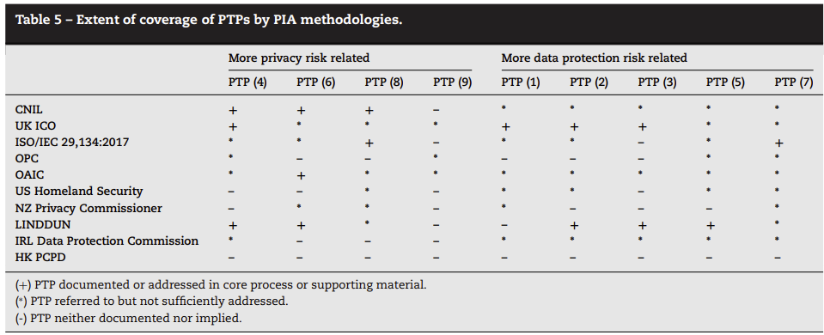
RQ2: To what extent do the PIA methodologies that have received attention in the reviewed literature, cover the risks identified in RQ1.1 and RQ1.2?
CNIL: Good coverage of most privacy related PTPs, but not of the more data protection related PTPs.
UK ICO PIA: Exactly the opposite of CNIL
LINDDUN : Broadest coverage with two out of four privacy related PTPs and three out of five data protection related PTPs sufficiently covered.

Slide 21

Overall, No single PIA methodology
appears capable of addressing all Big Data Analytics-specific
privacy and data protection risks !

Slide 22
04.
DISCUSSION AND FUTURE WORK

Slide 23
DISCUSSION
This literature review provides a qualitative analysis of existing PIA methodologies that could be used to assess privacy or data protection risks for applications relying on Big Data Analytics technologies
The study also revealed existing PIA methodologies’ weaknesses and strengths with respect to privacy and data protection impact assessment in Big Data Analytics environments
It also helps obtain a broad understanding of how to better address Big Data Analytics-specific privacy and data protection risks in DPIAs imposed by the GDPR

Slide 24
FUTURE WORK
To design specific DPIA guidance for the Big Data Analytics context bottom up, but by considering both the nine categories of privacy and data protection risks defined in this paper as Privacy Touch Points and how these risks were addressed in PIA methodologies that cover them well.
Use Delphi technique by designing questionnaires and sending them to a panel composed of both privacy and big data experts.

Slide 25
05.
CONCLUSION

Slide 26
CONCLUSION
01.
Despite the large number of papers discussing the general use of privacy impact assessments, there is still a need for a methodology more pertinent to privacy and data protection risks in environments storing big data and applying Big Data Analytics algorithms.
02.
The research goal is to develop a more comprehensive DPIA methodology to suggest improvements that would enable organisations and data controllers alike to identify weaknesses and possible legal infringements in their processing operations involving Big Data Analytics.

Slide 27


Slide 28

Q & A
Since we saw from the paper that the PIA bodies are mostly concentrated in the North America and Europe. Let’s dig a bit deeper into our surrounding.
Are you aware of any Data Privacy Regulatory Bodies in Asia ?

Slide 29
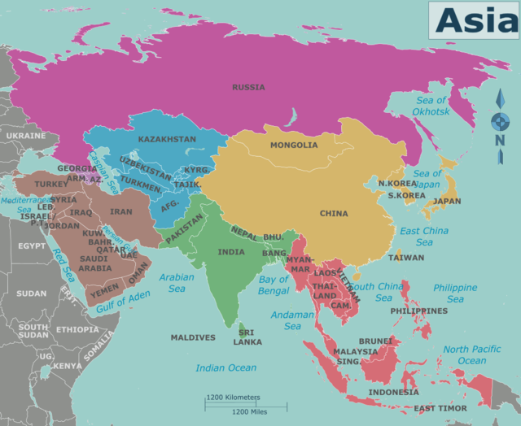
ANSWER
THAILAND:
Name of law: Personal Data Protection Act 2019 (PDPA).
Supervisory authority: Personal Data Protection Committee (PDPC).
SINGAPORE
Name of law: Personal Data Protection Act 2012 (2020 Revised Edition) (PDPA).
Supervisory authority: Personal Data Protection Commission (PDPC), under the Infocomm Media Development Authority.
VIETNAM:
Name of law: Decree on Personal Data Protection (Decree).
Supervisory authority: Ministry of Public Security (MPS).
JAPAN
Name of law: The Act on the Protection of Personal Information (2003) and amendments (last implementation April 2023 ). Revised guidelines released September 2022.
Supervisory authority: Personal Information Protection Committee.
Many countries in Asia have data protection laws or regulations that require organizations to assess the privacy implications of their data processing activities. They might not be as prevalent as the western countries but its growing.

Slide 30
REFERENCES
https://www.dataguidance.com/
\
https://www.privacyworld.blog/privacy-asia-pacific/
https://www.mofo.com/resources/insights/230130-new-wave-of-privacy-laws-in-the-apac-region
https://www.mineos.ai/articles/the-state-of-data-protection-in-asia
https://www2.deloitte.com/content/dam/Deloitte/sg/Documents/risk/sea-risk-unity-diversity-privacy-guide.pdf

